Slide 1
Rock, Paper, Scissors Program
Luci Barnett and Lyn Detwiler

Slide 2




Import Random
Import random so that the computer (opponent) can randomly choose rock, paper, or scissors to compete against the user.

Slide 3
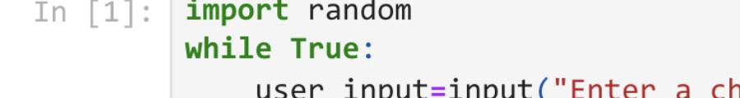
Loop
The while loop causes the code to continue running until the user enters “no” to quit

Slide 4
Definitions
User_input = allows an input from the use to compete against the computer
Actions = a list of responses (rock, paper, and scissors) that the computer can choose from at random
Active = allows the “while” loop to continue running until the user decides to quit
Computer_input = Allows the computer to chose from the pervious list at random

Slide 5
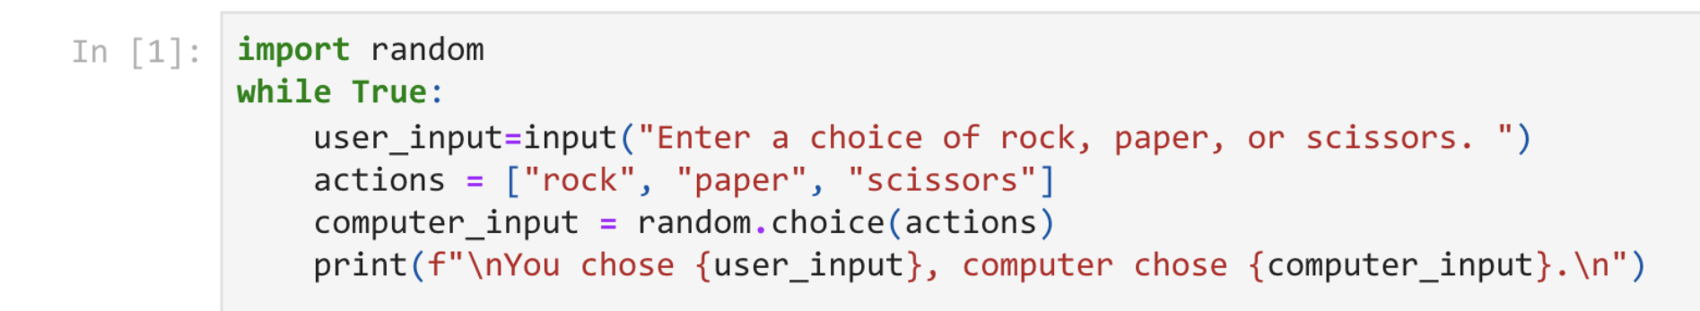
Definitions

Slide 6
If, Elif, and Else Statements in a Loop
These if, elif, and else statements provide the parameters of winning and loosing each game of Rock, Paper, Scissors.
Rock beats Scissors, Scissors beats Paper, and Paper beats Rock
Depending on what the user input is compared to the computer’s random input, there can be several different outcomes of each game.
These if, elif, and else statements count for all of these different outcomes and returns different code depending on those outcomes.

Slide 7
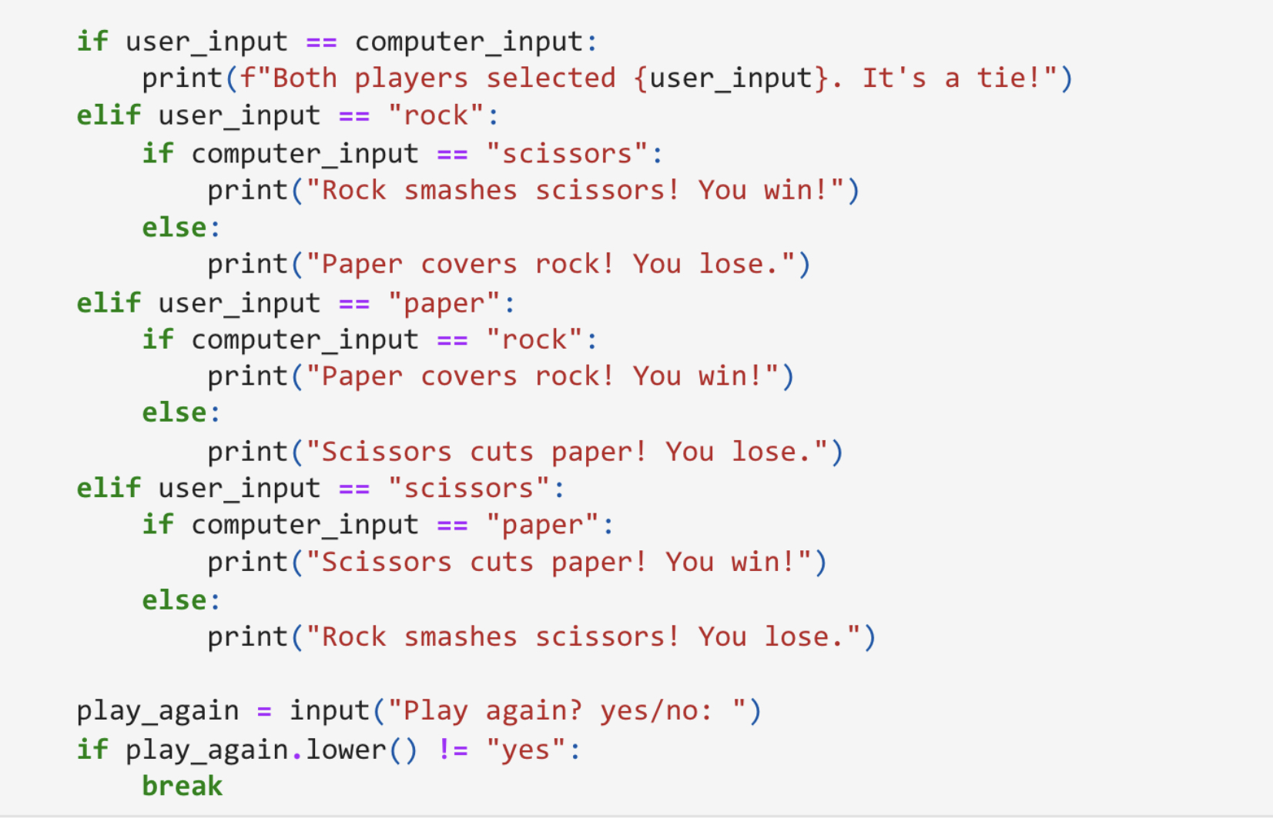
If, Elif, and Else Statements in a Loop

Slide 8


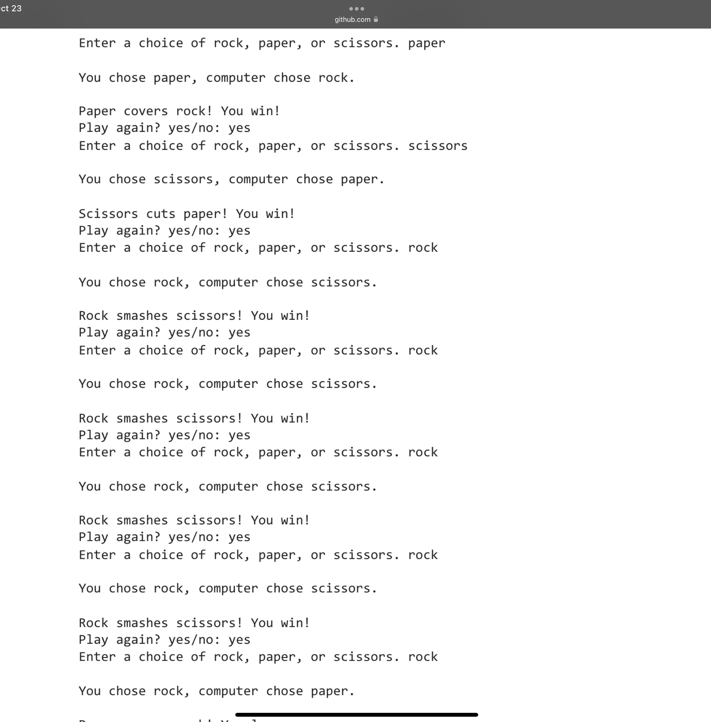

Examples of Gameplay

